Slide 1
Digital Logic Design
Chapter 7
Registers, Counters and the Memory Unit

Slide 2
Introduction
An MSI circuit that contains storage cells within it is a sequential circuit.
These MSI circuits are classified in one of three categories: registers, counters or random access memory.
A register is a group of binary storage cells suitable for holding binary information.
A counter is a register that goes through a predetermined sequence of states upon the application of input pulse.
A memory unit is a collection of storage cells together with associated circuits needed to transfer information in and out of storage.

Slide 3
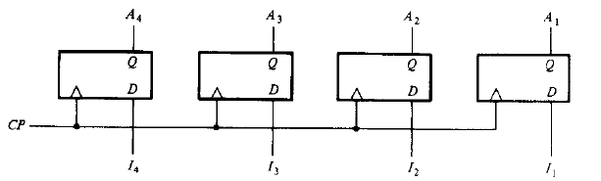
Registers
The simplest possible register is one that consists of only flip-flops without any external gates.
The clock pulse input, CP, enables all flip-flops so that the information presently available can be transferred into 4-bit register.

Slide 4
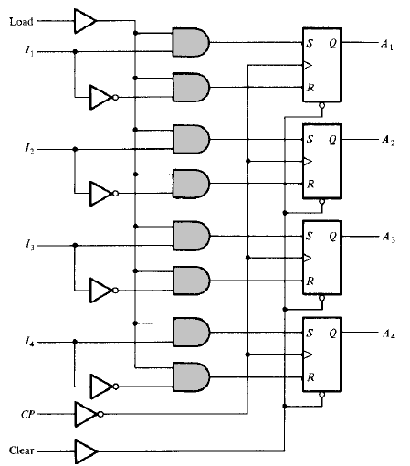
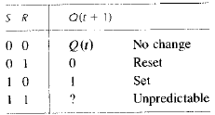
Register with Parallel Load

Slide 5
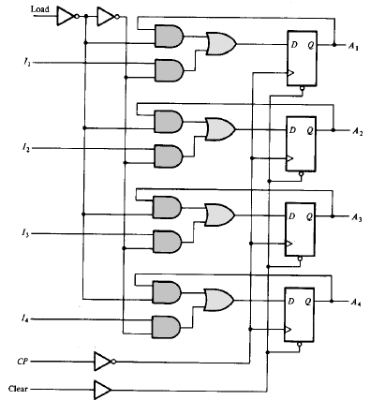

Register with Parallel Load

Slide 6
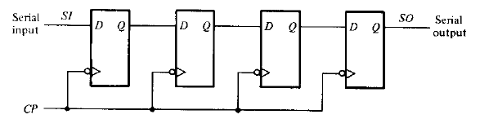
Shift Registers
A register capable of shifting its binary information either to the right or to the left is called a shift register.
The logical configuration of a shift register consists of a chain of flip-flops connected in cascade, with the output of one flip-flop connected to the input of the next flip-flop.
All flip-flops receive a common clock pulse.

Slide 7
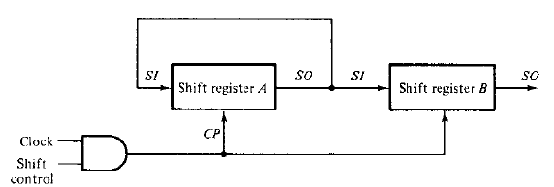
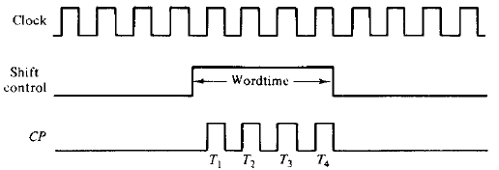
Serial Transfer
A digital system is said to operate in serial mode when information is transferred and manipulated one bit at a time.
The serial transfer of information from register A to register B is done with shift registers.

Slide 8
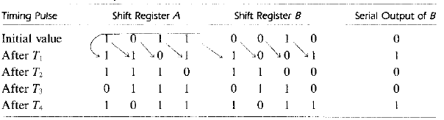
Serial Transfer
Assume that the binary content of A before the shift is 1011 and that of B, 0010.
In each of four pulses T₁, T₂, T₃ and T₄ , the rightmost bit of A is shifted into the leftmost bit of B and at the same time, the bit is circulated into the leftmost position of A.

Slide 9
Bidirectional Shift Register with Parallel Load
The most general shift register has the following capabilities:
A clear control to clear the register to 0.
A CP input for clock pulses to synchronize all operations.
A shift-right control to enable the shift-right operation.
A shift-left control to enable the shift-left operation.
A parallel-load control to enable a parallel transfer.
n parallel output lines.
A control state that leaves the information in the register unchanged even though clock pulses are continuously applied.

Slide 10
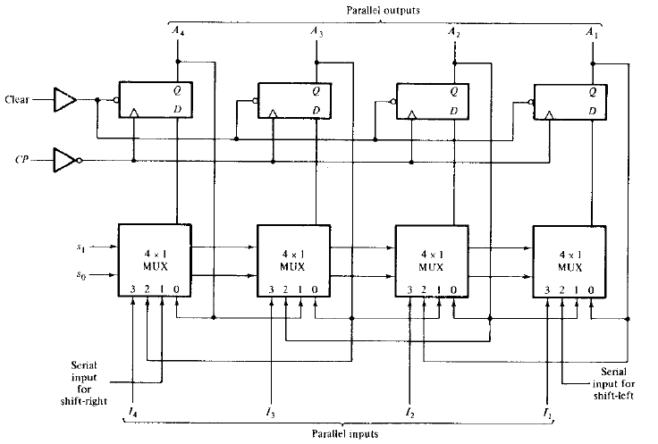
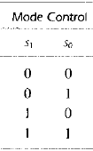
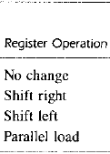
Bidirectional Shift Register with Parallel Load

Slide 11
Serial Addition
Two binary numbers to be added serially are stored in two shift registers A and B.
Two least significant bits from A and B are added together through a full-adder FA.
The carry from the full-adder is transferred to a D flip-flop to use it for the next pair of LSBs.

Slide 12
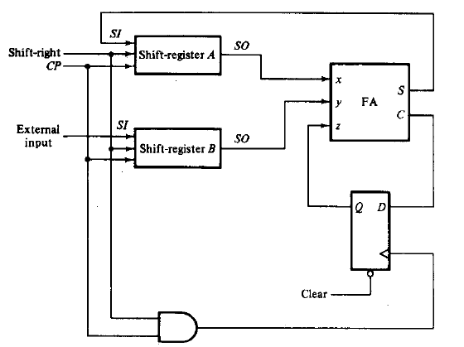
Serial Addition
A: 1010
A: 1010
A: 1101
A: 1110
A: 0101
B: 0100
B: 0001
B: 0000
B: 0000
B: 0010

Slide 13
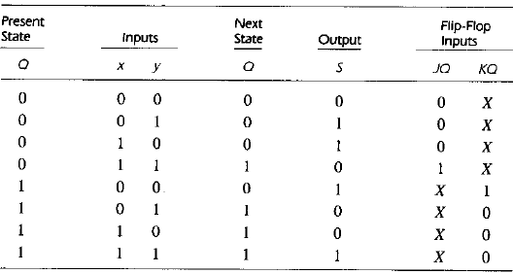

Serial Addition
Design a serial adder using a sequential-logic procedure.

Slide 14
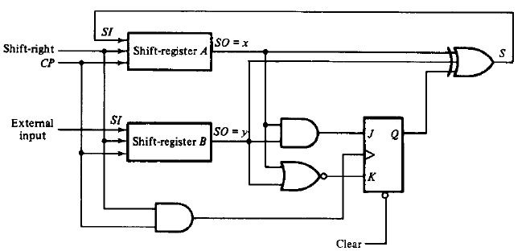
Serial Addition
Design a serial adder using a sequential-logic procedure.

Slide 15
Ripple Counters
Ripple counters are called asynchronous counters.
Here, the flip-flop output transition serves as a source for triggering other flip-flops.
The CP inputs of all flip-flops (except the first) are triggered not by the incoming pulses but rather by the transition that occurs in other flip-flops.

Slide 16
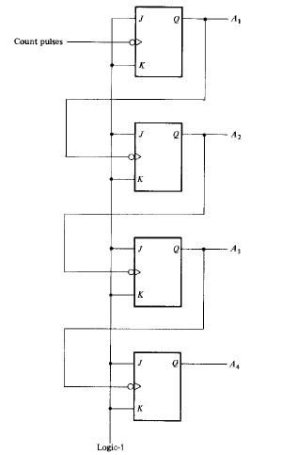
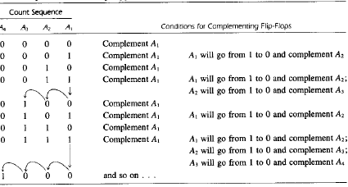
Binary Ripple Counter

Slide 17
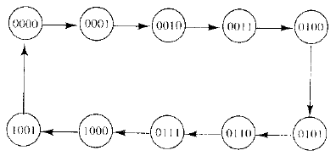
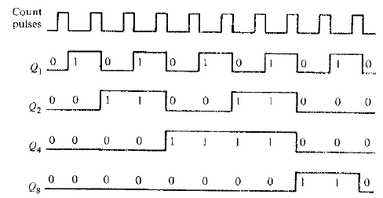
BCD Ripple Counter

Slide 18
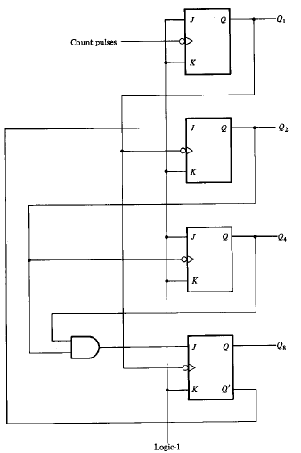
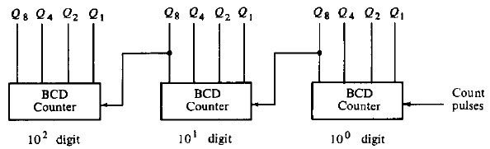
BCD Ripple Counter
0 0 0 0
0 0 0 0
0 0 0 1
0 0 0 0
0 0 0 0
1 0 0 0
1 0 0 1

Slide 19
Synchronous Counters
Synchronous counters are distinguished from ripple counters in that clock pulses are applied to the CP inputs of all flip-flops.
The common pulse triggers all the flip-flops simultaneously, rather than one at a time in succession as in the ripple counter.

Slide 20
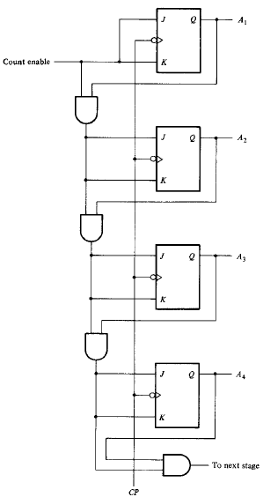
Binary Counter
In a synchronous binary counter, the flip-flop in the lowest-order position is complemented with every pulse.
A flip-flop in any other position is complemented with a pulse provided all the bits in the lower-order positions are equal to 1.

Slide 21
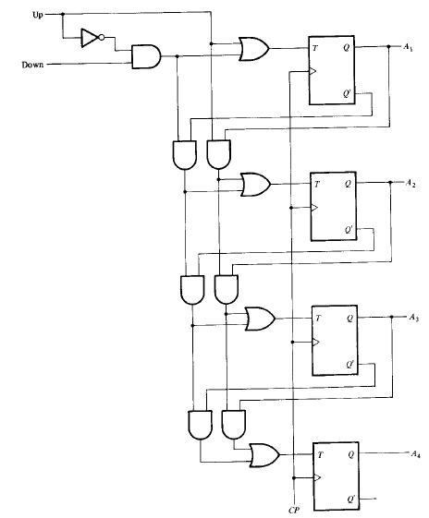
Binary Up-Down Counter

Slide 22
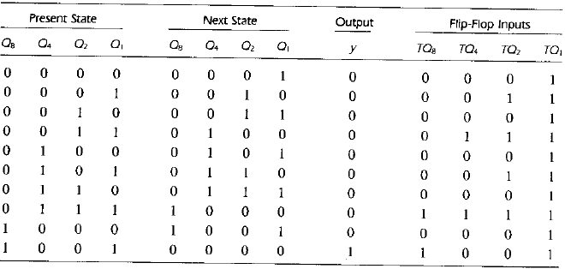
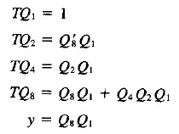
BCD Counter

Slide 23
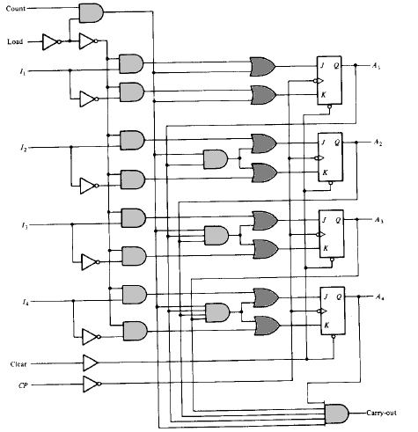
Binary Counter with Parallel Load

Slide 24
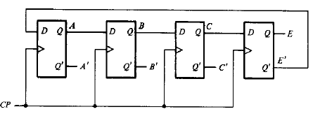
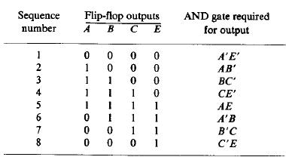
Johnson Counter
A Johnson counter is a k-bit switch-tail ring counter with 2k decoding gates to provide outputs for 2k timing signals.

Slide 25
Johnson Counter
The eight AND gates listed in the table, when connected to the circuit will complete the construction of the Johnson counter.
Since each gate is enabled during one particular state sequence, the outputs of the gates generate eight timing sequences in succession.

Slide 26
The Memory Unit
A memory unit stores binary information in groups called words, each word being stored in a memory register.
Two control signals (read and write) specify the direction of transfer required, that is, whether a word is to be stored in a memory register or whether a word previously stored is to be transferred out of a memory register.
The memory address register specifies the memory word selected.
The memory buffer register holds the information that is to be transferred to the memory unit or have been transferred from the memory unit.

Slide 27
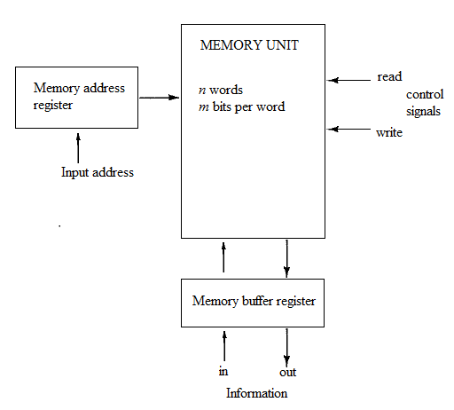
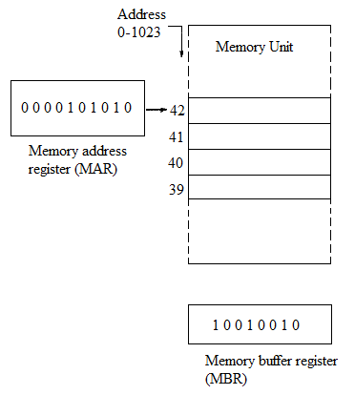
The Memory Unit

Slide 28
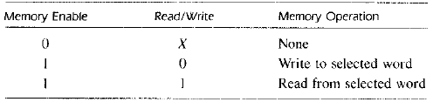
Write and Read Operations
Steps for write operation:
Transfer the binary address of the desired word to the address lines.
Transfer the data bits that must be stored in memory to the input lines.
Activate the write input.
Steps for read operation:
Transfer the binary address of the desired word to the address lines.
Activate the read input.

Slide 29
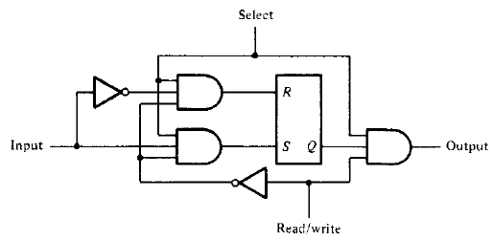
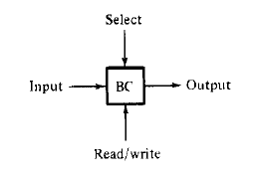
Memory Decoding

Slide 30
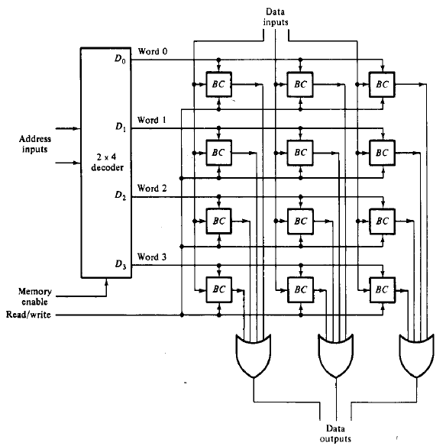
Memory Decoding

